Slide 2

THE SHOW
MINExpo, owned and produced by the National Mining Association, brings professionals, experts and decision-makers from the global mining industry together. The show floor will feature mining products for safety, drilling, engineering, materials handling, training & HR and much more.
3
EXHIBIT HALLS
1,900+
INDUSTRY
SUPPLIERS
44,000+
MINING INDUSTRY
PROFESSIONALS
65,000+
SQUARE METERS OF MINING
EQUIPMENT AND SERVICES

Slide 3


Slide 4

ABOUT NMA
The National Mining Association (NMA) is the only national trade organization that serves as the voice of the U.S. mining industry and the hundreds of thousands of American workers it employs before Congress, the federal agencies, the judiciary and the media, advocating for public policies that will help America fully and responsibly utilize its vast natural resources.

Slide 5
WHERE THE INDUSTRY MEETS
Industry Sectors
  Precious metals
  Nonferrous metals
  Ferrous metals
  Coal
  Industrial minerals
  Stone mining & quarrying
  Sand & gravel
Phases of Mining
  Open-Pit Mining
  Underground Mining
  Processing/Preparation
  Mine Site Development
  Exploration & Surveying
  Reclamation/Closure
  Smelting & Refining

Slide 6
PRODUCT CATEGORIES
More than 1,900 exhibitors will showcase their latest equipment, services and technology
  Assay Equipment
  Auger Mining Equipment
  Automation & Robotics
  Blasting Agents
  Coal Cutting Machines
  Communication & Tracking Equipment
  Drills- Dozers- Dredges
  Electric Motors & Generators
  Environmental Services
  Exploration Equipment
  Financial Services
  Fuels & Additives
  Global Positioning Systems
  Heavy Equipment Transport
  Industrial Fasteners- Jacks & Pulleys
  Lighting Systems- Locomotives- Maintenance
  Metals & Special Alloys
  Noise Control Equipment
  Pneumatic Tools- Process Controls
  Refueling Systems
  Roof Support Equipment
  Safety Equipment
  Security- Shovels
  Tracked Vehicles- Water Treatment

Slide 7
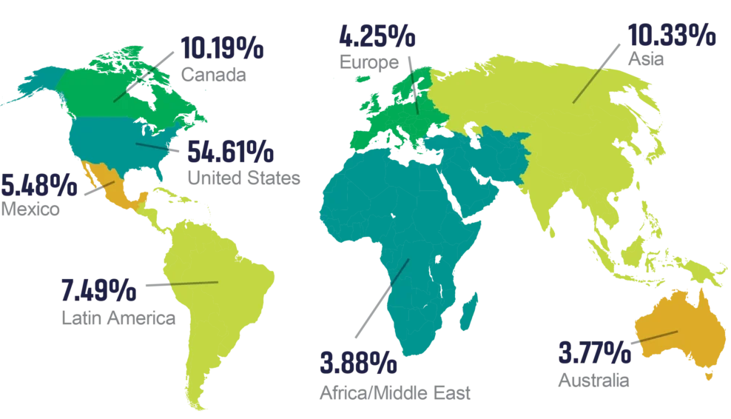
INTERNATIONAL ATTENDANCE
More than 16,000 MINExpo attendees are from countries outside the U.S.

Slide 8
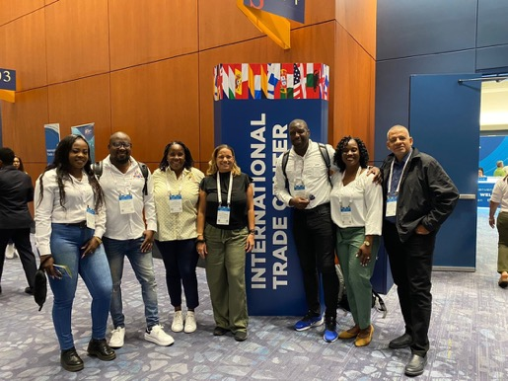
THE TEPP PROGRAM
MINExpo is a proud participant of the U.S. Department of Commerce’s Trade Event Partnership Program (TEPP).
Through the Department of Commerce’s network of U.S. Commercial Service (USCS) offices in U.S. Embassies and Consulates worldwide, trade specialists organize buyers’ delegations and bring them to selected trade shows in the United States, connecting them with U.S. companies.

Slide 9
BENEFITS FOR DELEGATIONS
Dedicated assistance from an in-country specialist
Complimentary registration, valued at up to $300 USD
Special discounts and help with hotel arrangements
Complimentary shuttle bus transportation
On-site support
Access to the International Business Center (IBC)
Personalized letters of invitation

Slide 10

LAS VEGAS
Is it any wonder Las Vegas is known as the trade show capital of the world? Make the most out of your stay while you come to MINExpo
  World Class Dining, Shopping, and Gaming
  Concerts and Entertainment
  Day trips to the Grand Canyon, Hoover Dam, Antilope Canyon, and more!
  Tour of some of the largest modern mines in the U.S. – Check Travel Nevada for more information.

Slide 11
INTERESTED IN JOINING A DELEGATION?
Contact __________ (fill with your contact information)
Check if you need a visa and start your application
Book your hotel and flight early
  Discount room block rates are accessible through registration.
Follow MINExpo’s social media:
  X: @MINExpoIntl
  Facebook: MINExpo INTERNATIONAL
  Instagram: minexpointl

Slide 12
THANK YOU!
We are looking forward to seeing you in Las Vegas

